Slide 1


Class starts @ 6pm sharp
Software
Development
Week 1 - Class
Please ensure your microphone is muted but working at the start of class.
To test your microphone, do a test before you get started by using: https://www.onlinemictest.com/

Slide 2

Software Development
Week 1: Class
lisa.murphy@ncirl.ie

Slide 3



Agenda
Class Schedule
Reading Material
Computing Support

Slide 4


Where do I come from?
ABOUT ME
Lisa Murphy
From Galway
11 years teaching in NCI!

Slide 5


Class Schedule
Class Schedule?
Lecture
Friday 6-8pm
Lab
Friday 8-10pm
What will I Learn?
Programming Basics – Week 1
Data Types – Week 2
Instantiable Classes – Week 3
Selection Statements and nested conditionals – Week 4&5
Repetition – Week 6
Arrays – Week 7
Nested Loops a&2D Arrays– Week 8
Characters & Strings – Week 9
Recap – Week 10
OOP Revisited – Week 10, 11
Revision – Week 12
Assessment
Breakdown
50% CA [Week 6 Release]
50% TABA [End of term]

Slide 6
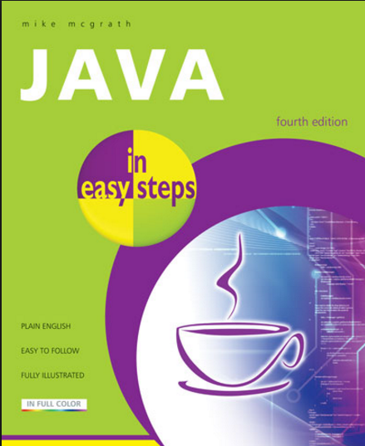
Reading Material

Slide 7
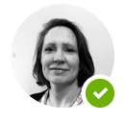
Computing Support Service
Julie Power
Email: Julie.power@ncirl.ie

Slide 8

YouTube Sensation
Part 1: Programming Basics
Frances Sheridan
School of Computing
https://www.youtube.com/user/fsheridanprogramming

Slide 9

Now its time to get Programming!
All notes are included on my Moodle page should you require further reading material.

Slide 10
What is Programming?
A computer program is a set of instructions that you write to tell a computer what to do.
Computers are constructed form circuitry that consists of small on/off switches – so you create a program by turning on and off these switches.
A low level language – machine language – a language a computer understands.
A high level language – java – a language that humans understand.
Programmers often say that machine language consists of 1s and 0s. This means you use the 1s and 0s to correspond to the on and off switches

Slide 11

High Level Language
A series of program statements similar to an English sentence are written to carry out the task you want to perform.
A high level language compiler or interpreter is used to translate the statements into machine language.
A compiler translates the entire program before carrying out the statement or executing it.
Program statements are known as commands.

Slide 12
Understanding OOP
OOP – Object Oriented Programming
A class is a term that describes a group or collection of objects with common properties.
A class definition describes what attributes its object will have and what those objects will be able to do.
Attributes are the characteristics that define an object.
The values contained in objects properties differentiate objects of the same class from one another.
An object is a specific, concrete instance of class. When you create an object instance, you instantiate it.

Slide 13
My First Java Application
public class First { public static void main (String args[]) { System.out.println(“First Java Application”);
} }
System.out.println(“First Java Application”);
This statement does the actual work in the program.
Like ALL java applications the statement ends with a semicolon (;)
The text “First Java Application” is known as a literal string. That is, a series of characters that will appear in output exactly as they have been entered. All literal strings are surrounded with double quotation marks.

Slide 14

Class Definition
<modifier> class <classname> { …
}
General format for all classes:
<modifier>
public, private, protected, or blank
For now we will use public.class is a java identifier this is a reserved word

Slide 15
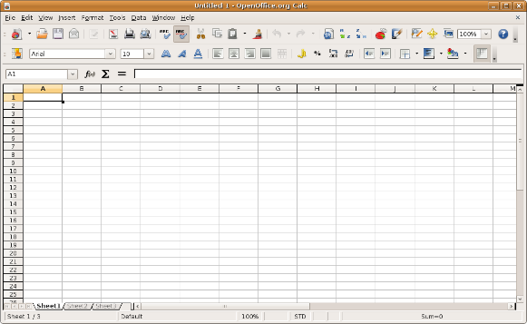
Class Definition
<classname>
The name you give your class
Must begin with a capital letter.
It cannot begin with a digit/number.
The rest of the name can only contain numbers or letters.
Multiple words can be joined together – by convention subsequent words start with a capital letter.
No spaces between multiple words.
All contents of the class are surrounded with curly brackets {,}

Slide 16
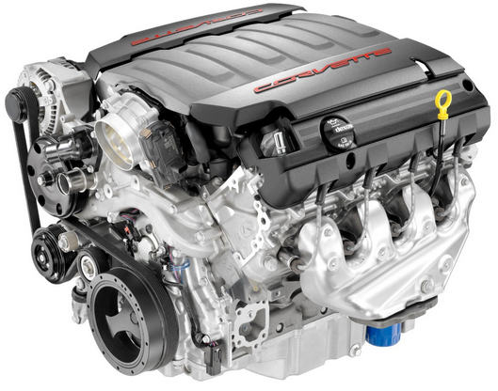
Main Method
Every Java program must have a main method.
Think of this as the engine of the program.
public static void main (String args[]) { …
}
Main Method
Engine of the Program

Slide 17
Comments
Block Comments
/* this is an example of a block comment
you can have multiple lines
*/
Inline Comments
// This in an example of an inline comment
// Each new line starts with (//)

Slide 18

Saving, Compiling, Running
First write and save your java class
Compile the class you wrote (called the source code) into bytecode
You use the Java Interpreter to translate the bytecode into executable statements.

Slide 19

Errors
Compilers issue one or more error messages each time they encounter an invalid program statement
– this is known as a syntax error.
Programs must be debugged before they can be executed
– locating and repairing all syntax errors.
As well as syntax errors we can have what are known as logical or semantic error. This is can be more complicated to correct.
Syntax Error
– For example, if you misspell a programming language word.
Semantic Error
– For example, if you use a correct word in the wrong context.

Slide 20
Recap
/*
*MyFirstProgram.java
*@author L Murphy
*8th June 2014
*/
//This starts the program – Every program has a Class
Public class MyFirstProgram{
//Engine of the program
Public static void main (String args[]){
//To print data to the screen
System.out.println(“MyfirstProgram”)

